Slide 1
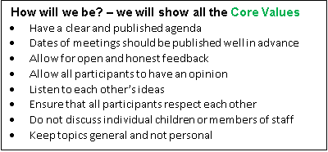
Are we still happy with these?

Slide 2

Growing Great…
…Responsibility
…Courage
…Compassion
…Respect
Our GREAT aims for all at Baldwins Hill…
Be successful – to have the motivation to learn new things, build on learning and make a positive contribution to the learning of others, too.
…relationships
…attitudes
…thoughtfulness
Have a positive impact on others and the world around us by the way we care, speak and behave.
…love of learning
…behaviour
…independence
Feel a sense of self worth and belonging, celebrating our own and others’ individuality.
…teamwork
…and so many other things!

Slide 3
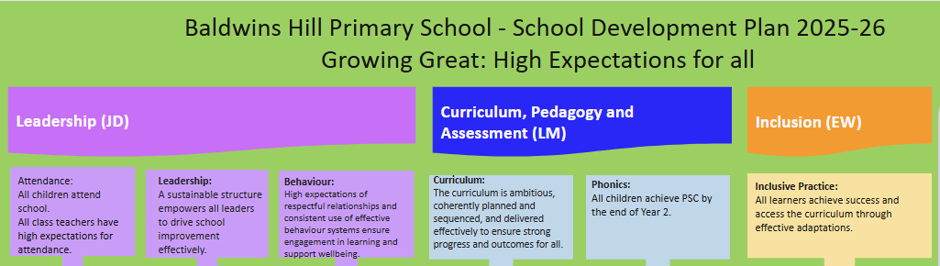

Slide 4
Read, Write, Inc is in full swing!
Children grouped by sounds they need to learn rather than whole class learning regardless of progress/needs
Children regrouped as soon as they are ready to move on
So far 78% of the children on the scheme have already moved groups at least once due to making swift progress with their sounds.

Slide 5
New schemes launched for:
Science, R.E, History, Geography, Art – children enjoying their learning even more in these subjects as they are being taught each week – the older scheme grouped subjects together at different times in the year.
Children able to articulate their learning and use subject specific vocabulary more effectively and accurately.

Slide 6
Homework – thoughts?

