Slide 1

Transition for Children with Additional Needs
March 2022
Emily Webster
Head of Trust Inclusion

Slide 2

Concerns
What are your concerns?

Slide 3
What school offers
Teacher meetings to exchange information
SENCO meetings to exchange information
File exchange to pass on information
Visits
Timetable and maps
Extra visits
Question and answer sessions
Visual supports like timetables
Social stories around change can be written
Photo books can be created

Slide 4
Making choices
Open days/evenings – Autumn term
1:1 visits – can be arranged before
Contact the office for more information
The SENCo at secondary school will be able to offer more information
Look on the secondary school’s website for more information

Slide 5
Making choices
Look at what the basic offer is
Consider what your child needs in addition
Ask for what you think they might need

Slide 6
Listen to Concerns
The best way to reassure someone about any transition is to first listen to their concerns and acknowledge that their feelings are valid.
Provide reassurance that whatever they are feeling is OK. As adults, we often want to rush in and fix problems or help to logically explain away the concerns.
Focus on the feelings and emotions rather than on practicalities at this stage. Some fear or concern about change is normal and it is this degree of concern that helps us to make plans to ensure our safety.

Slide 7

Responses to worries
As parents we want to fix things. Try not to do this.
Instead of saying,“You're too young to worry about that" , try "I can see how that would make you feel worried."
Instead of, “You don't need to feel sad" , try “It's understandable that this would make you feel sad."
Instead of, “Just forget about it" , try asking them what their feelings are about it.

Slide 8

Involve your Child
A PROBLEM-SOLVING APPROACH
Once your child has told you about their feelings they can be encouraged to focus on what they can do to manage.
Particularly with older children, a problem-solving approach can be helpful.
Encourage them to generate a range of possible solutions to the problems they raise. Then help them to select the ones that they think will work best for them.

Slide 9

Focus on the positives
Encourage your child to talk about the things they are looking forward to.
If they can’t think of anything, ask them to have a think and you will speak again later. Ask them to think of just one thing. You could also suggest some things for them to choose from.

Slide 10

Share Information
Provide as much information as possible.
Emphasising what will be the same will be reassuring to your child.
Remember to use the tools provided by the new school or class.

Slide 11
Ask for more
More information can be asked for especially if your child has a question that hasn’t been answered.
Social stories can be written by school to help – please ask for what you now your child needs.
Ask for extra visits.

Slide 12
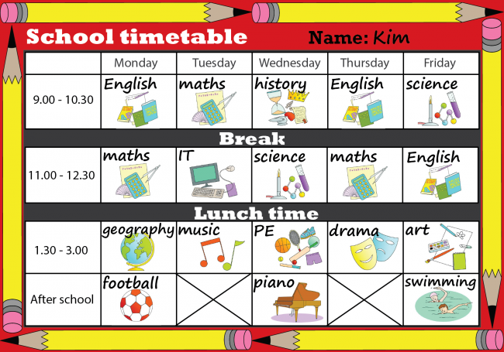
Routine
Go over new routines
Use the tools given e.g. timetables
Practise new routines like routes to school

Slide 13

Educational Psychology
If your child is particularly anxious and you have already sought all the help possible from school.
https://westsussex.local-offer.org/information_pages/608-resources-and-advice-for-supporting-home-learning

Slide 14
Further Resources
https://sussexcamhs.nhs.uk/help-support/young-people/anxiety-yp/
http://www.oswaldroad.co.uk/wp-content/uploads/2020/07/7waysanxiety.pdf
https://www.annafreud.org
https://youngminds.org.ukhttps://www.familylives.org.uk/advice/your-family/family-life/back-to-school-transition-after-lockdown/

Slide 15

If you have any questions please contact your child’s class teacher.

