Slide 1

Inclusion Parent Forum
Nov 2021

Slide 2
Assessment of children with SEND

Slide 3

Welcome
- Thank you for joining us
- Inclusion parent forums
- Ground rules
Notes:
So lovely to see you – thank you for coming
What is an inclusion parent forum?
Everyone is welcome.
Rather than whole school issues we discuss issues related to inclusion and pupils with special educational needs.
A safe space for parents to meet and ask questions. For us to share information and discuss topics. To gain parent voice and plan together e.g. transition ideas.
Usually in separate school groups.
Hope to meet together in school – how do people feel – advantages of the virtual world.

Slide 4
Ground Rules
Respect views of others
Be open and honest
Accept any ideas
Do not discuss individuals (children or staff)
Keep topics general and not personal
Notes:
So lovely to see you – thank you for coming
What is an inclusion parent forum?
Everyone is welcome.
Rather than whole school issues we discuss issues related to inclusion and pupils with special educational needs.
A safe space for parents to meet and ask questions. For us to share information and discuss topics. To gain parent voice and plan together e.g. transition ideas.
Usually in separate school groups.
Hope to meet together in school – how do people feel – advantages of the virtual world.

Slide 5
Agenda
What does assessment look like in the classroom?
How do we track children’s progress?
What assessments do we use additionally?
Ideas for future forums
Questions

Slide 6
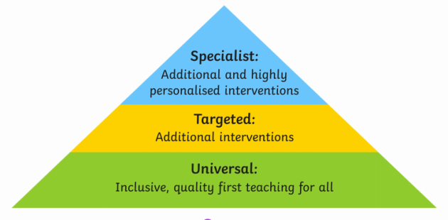
Quality First teaching
All of our learners receive quality first teaching following this model;
Universal Teaching
All teachers thoroughly plan each lesson inclusively so that there are clear learning objectives alongside activities to help all children meet the learning outcomes.
Targeted - Additional Interventions
This can be used to provide extra support to pupils who are not quite meeting age-related expectations. This involves identifying these pupils and taking the necessary steps to personalise their learning experience so that they can get back on track in their learning journey.
Specialist - Personalised Interventions
Teachers create a personalised learning program for students struggling to meet age-related expectations. This step is for students who require more support than is provided in additional interventions and support in class.

Slide 7
How are assessments made?
Within lessons teachers are constantly reviewing learning and assessing your children through:
- targeted questions
- class discussions
- 1:1 discussions
- response to modelling and scaffolding
- looking through work and giving verbal feedback
- peer assessment of work against success criteria
- self assessment of work against success criteria
Planning evolves throughout the week. Adjustments are made based on progress within the class and any misconceptions.

Slide 8
For some of our children that need targeted and specialist support this is what it may look like in class.
Targeted and specialist support in class, examples of what teachers put in place.
Use of extra resources to support e.g. number lines, counters and key word cards.
I can statements written in by teacher.
Pre-learning of a concept that is going to be introduced in a main lesson through small group work during assembly time or fast learning time. Pre-learning is also shared with parents at times.
Task boards – to help break down instructions and learning into smaller steps.
Small group activities during challenge times to support the understanding of the I can statements.
Targeted early morning tasks for children based on their FLC targets or those on a provision document or ILP.
Highly differentiated activities based on ability.
Formal assessments are age related for children to complete to inform assessment further.
Homework set to help support and embed learning. These are also planned to the level appropriate to your child.
Nessy programme is used for children that are dyslexic, EAL or below age related expectations from Year 1.
Intervention groups to focus on key skills – numeracy, phonics, spellings, handwriting etc.

Slide 9
Assessment through the year
Formal assessments are completed throughout the school year alongside the teachers daily assessments of progress within a lesson. These assessments inform daily planning.
Assessments can be to used to assess progress at age related expectations or customised to the age expectations band that your child is in, for example a child in Year 4 could be working at Year 2 expectations and will therefore be assessed within this age group.

Slide 10
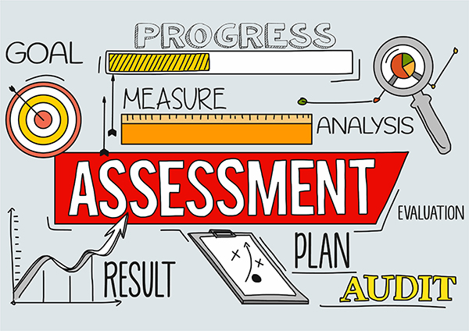
New system
We are now using a new assessment system. This will now show every child's progress which is unique to them; previously children were formally assessed as below, at age related or above expected for the year group they were in.
Now progress will be tracked across the year group age that the child is working in. This will show that although progress may be below age expectation there is progress within the year making assessment inclusive for all.

Slide 11
Target setting
Family Learning Agreements and Individual Learning Plans (ILPs) are used to set targets for learners.
Teachers assess whether the target has been met and what needs to be targeted next.

Slide 12
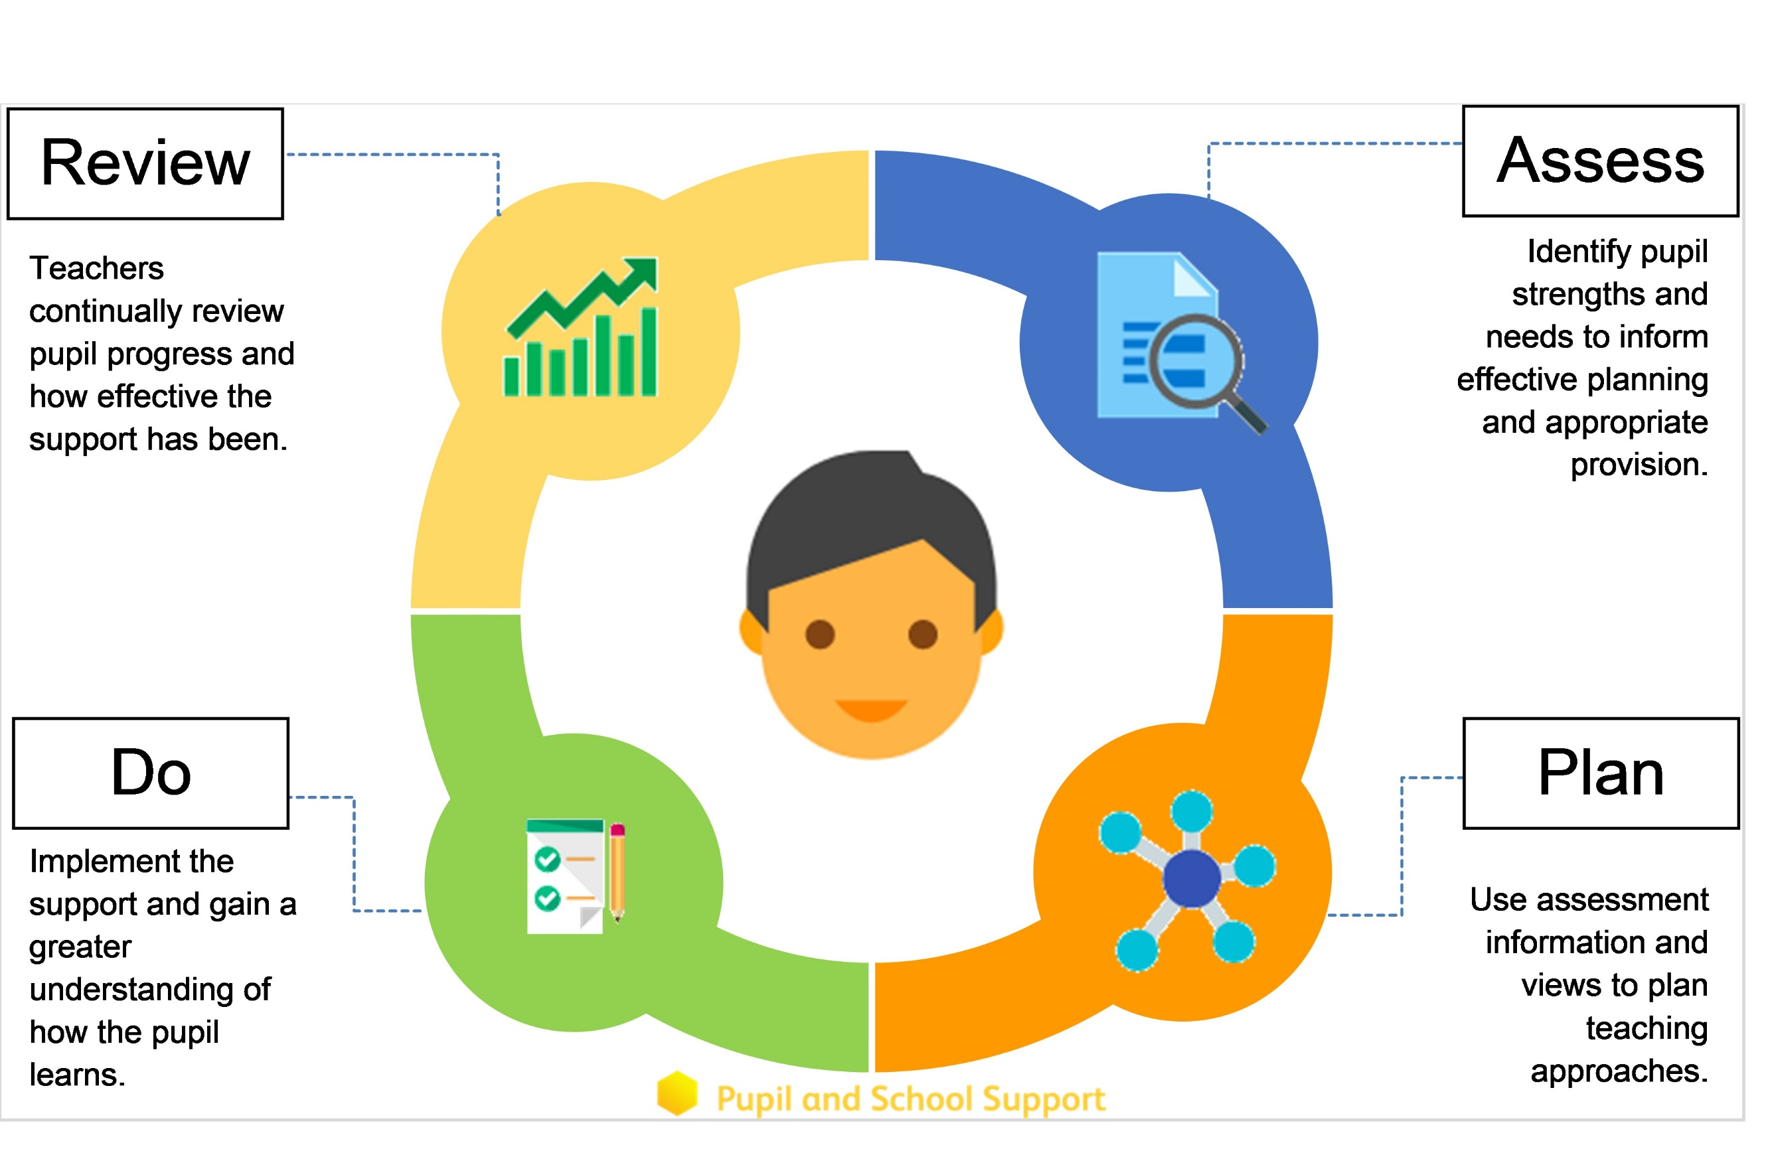
Notes:
We work within the framework of assess, plan, do, review
Read each section on the slide
If we find that a child is not progressing or developing despite support being given we might consider involving outside agencies.

Slide 13
Quality First Teaching - Universal
Achievement Teams
School Support 1
School Support 2
School Support 3
EHCP
Notes:
Graduated approach

Slide 14
What assessments do we use additionally?
CHECKLISTS
Indication of need
Attention Deficit and Hyperactivity Disorder (ADHD)
Sensory checklist
Social communication checklist
Speech progression tool
Concept checklist
SCREENERS and ASSESSMENTS
Numerical information e.g. standardised score
Dyslexia screener
Sandwell maths assessment
Suffolk reading assessment
SPAR spelling assessment

Slide 15
How do we track children’s progress?
Statements are marked as complete on the system
Screeners and assessments can be compared over time
Example – Suffolk twice a year
Under 6 years – large band therefore they are tracked by raw score

Slide 16

Future Inclusion Forums
What do you like?
Even better if…
Topics

Slide 17

Any questions

